Slide 1
Literature Study this week;
Weekly Meeting (# 4)
TEA; PME; NTHU;
Good Afternoon Everyone
Microphone far-field array signal processing - Multiple Source amplitude and velocity estimation using Particle Filters:
Simulation in MATLAB for linear array and 2 dimensional array of microphones; Resampling module debugged;
Comparison with MVU estimator;
Results;
Plots;

Slide 2
A Bayesian approach to sound source reconstruction: Optimal basis, regularization, and focusing
-Jerome Antoni
Factors that matter:
Topology of the source surface.
A priori spatial distribution of the sources.
Geometry of the array.
Type of propagation (near-field or far-field, freefield or scattering).
Frequency range of interest.
Classical methods:
Beamforming; NAH; SONAH; IBEM; HELS; ESM; WSA;
Follow 2 step approach:
Interpolate the measurements onto some spatial functions whose propagation are known.
Reconstruct the source field by retropropagation.

Slide 3
The gist - 1
Fundamental question:
For a given source topology and array geometry, is there an optimal interpolation basis which minimizes the reconstruction error ?
Two important ramifications:
What is the dimension of such an optimal basis?
How does it affect the regularization?

Slide 4
The gist - 2
Main findings:
The optimal basis functions are the M eigen-functions of a specific continuous-discrete propagation operator, with M being the number of microphones in the array.
The a priori inclusion of spatial information on the source field causes super-resolution according to a phenomenon coined “Bayesian focusing.”
The approach is naturally endowed with an internal regularization mechanism and results in a robust regularization criterion with no more than one minimum.
It admits classical methods as particular cases.

Slide 5
Inverse accoustic problem
Common Ground of all methods:
Source field is reconstructed as a linear combination of spatial basis functions.
The coefficients of the basis functions are computed so as to match the measured field at the microphones.
Involves a mapping from a continuous space (source field) to a finite discrete space (sampled acoustic field at the array microphones).

Slide 6
The two sub-problems
Interpolation of the measurements onto the basis functions propagated at the microphones - involves a non-trivial choice of the basis functions.
Extrapolation (retro-propagation) by evaluating the interpolated field at the source surface - careful regularization so as to forbid unstable results, which in turn critically depends on the choice of the interpolation functions in the first step.

Slide 7
Bayesian Approach - The cost function aspect
Combines physical and probabilistic measures.
The minimization of such a cost function will return the optimal basis functions.
Interpretation of the latter in terms of
transfer of information ,
probability of good reconstruction,
an internal mechanism of regularization,
an explicit criterion to optimize the regularization parameter, and
an interpretation of the aforementioned focusing effect.

Slide 8
Link to Statistical Physics
Considers all unknown quantities of interest as random variables i.e. as “microstates” which are allowed to take different values in admissible ranges in order to reproduce the observed “macrostate.”
In the present paper,
Microstates are embodied by the source parameters—the coefficients assigned to spatial basis functions.
Macrostate corresponds to the measured pressures on the microphone array.
The randomness of the microstates is not fundamentally physical, but is merely an apparatus to reflect the experimenter’s lack of knowledge about the exact state of the system.
It may be construed as a collection of many systems which are statistically equivalent to the system under study, the so-called “Gibbs ensemble” in our analogy with statistical mechanics.

Slide 9
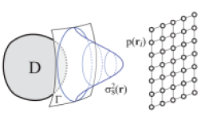
Problem Statement
Acoustic field produced by a radiating body D.
Measured at some discrete locations , i = 1,…, M by means of an array of M microphones.
Let be the source surface of interest which does not necessarily coincide with the body surface on which the source field s(r) is sought.

Slide 10


Source field-1
Aim of inverse problem: To extract s(r) from
Ill-posed in Hadamard’s sense.
a unique solution would require to measure the acoustic field over a whole surface enclosing the radiating body.
Methods estimate s(r) as:

Slide 11

Source field-2
Equivalently this can also be written as
where , k = 1,…, P are coefficients which depend on measurements p( ), i = 1,…, M and (r), k = 1,…, P are spatial basis functions that interpolate the source field independently of the measurements.
the unknowns of the problem are all at once the spatial functions (r) their coefficients and their number P (the dimension of the basis).

Slide 12


Bayesian Inference
Posterior distribution:
High value means that the measurements p explain the source
s(c, ) with a high probability.
This suggests viewing the posterior as a cost functional, whose maximization with respect to c and will then return the optimal parameters, that best explain the data, i.e., the so-called maximum a posteriori (MAP) estimates
Using Bayes’ rule:

Slide 13
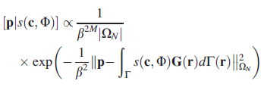

Likelihood function
Covariance Matrix:
where has a known structure (e.g., spatially white noise or isotropic noise) with normalization trace{ } = M so that reflects the mean energy of the noise (i.e., as obtained after averaging the noise energy over all microphones)
S
Here

Slide 14

The Prior Distribution-1
The spatial covariance function of the random field s(r), namely
Normalization: .
reflects the mean energy of the source.
The expectation operator is to be understood here as an ensemble average over all possible and admissible source fields before the experiment is performed.

Slide 15



The Prior Distribution-2
Here
In analogy with the Maxwell-Boltzmann distribution law of Statistical Mechanics:
can be viewed as the total energy of the microstates.
can be viewed as the temperature times the Boltzmann constant.

Slide 16
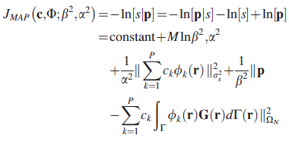

The Cost Function
This has to be minimized with respect to and
Singular Value Decomposition:

Slide 17


Skipping the mathematical details…
It can be proved that:
The optimal basis functions sought are the eigen-functions of above equation, i.e.
There are P = M of them and they are orthogonal through the aperture function i.e.
The optimal coefficients are
where stands for a noise to signal ratio.

Slide 18

Thus the reconstructed source field is
Remarkable Features:
The optimal interpolating basis does not depend on the measurements but only on
the topology of the source surface,
the geometry of the antenna,
the spatial structure of the measurement noise and
a priori available spatial information on the source field.
The dimension of the basis is exactly equal to the number of microphones in the array.

Slide 19
Skipping the details of
Physical and Probabilistic Interpretations of the optimal basis functions and their associated singular values .
Regularization.
Refer to the paper for details.

Slide 20


Bayesian Focusing
Consider a source field modeled a posteriori by a band-limited spatially white random field.
Let B be the effective wavenumber bandwidth of the field.
The energy of the field through the aperture is then returned by
The energy of the reconstructed field with measurement noise taken into account is

Slide 21


where P is the relative variance which is a good measure to measure the quality of the reconstructed source.
Thus the resolution surface of the reconstructed field is on the order of
This makes it clear that the narrower the aperture, the finest the spatial resolution. In other words, the aperture function plays the role of a lens in the retropropagation process.

Slide 22
Conclusions and Practical Implications
The elegance of the approach is to place the user’s choice at the highest level, in the formulation of the prior, which is surely more insightful and intuitive than the choice of norms.
The user is guaranteed to systematically obtain the smallest possible reconstruction error and is therefore released from the difficult choice of selecting a specific method.
The source is reconstructed with the minimum number of necessary basis functions, thus solving the difficult issue of fixing that parameter while implying at the same time a definite saving in terms of computation time and data storage.
The approach is general enough to apply over a wide range of configurations (near-field and far-field, low and high frequency ranges), and thus unifies most classical methods.

Slide 23
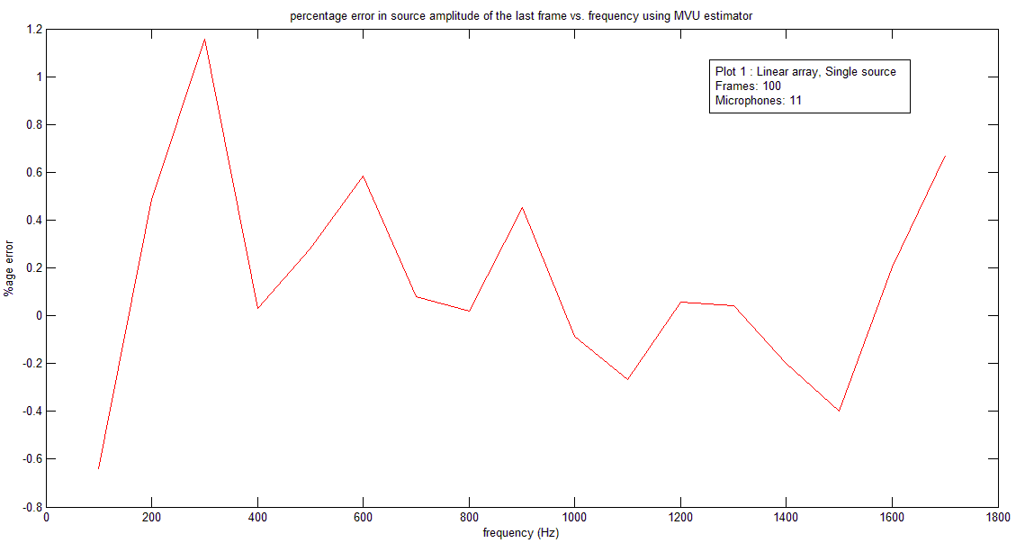
Simulation Results: Linear Array, Single Source

Slide 24
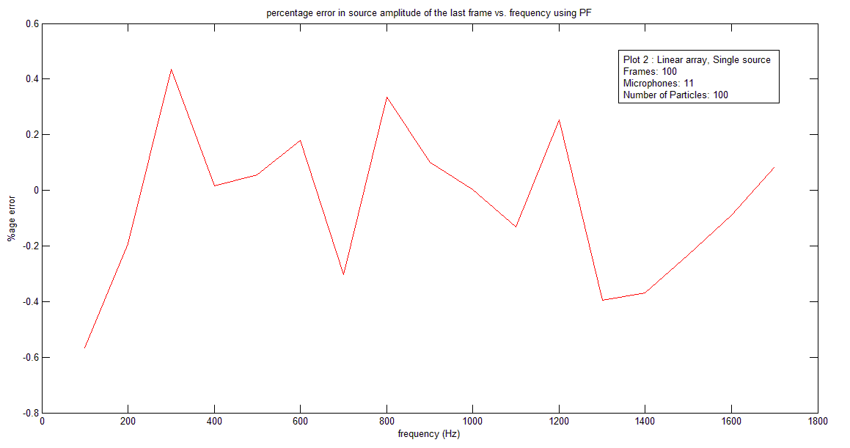

Slide 25
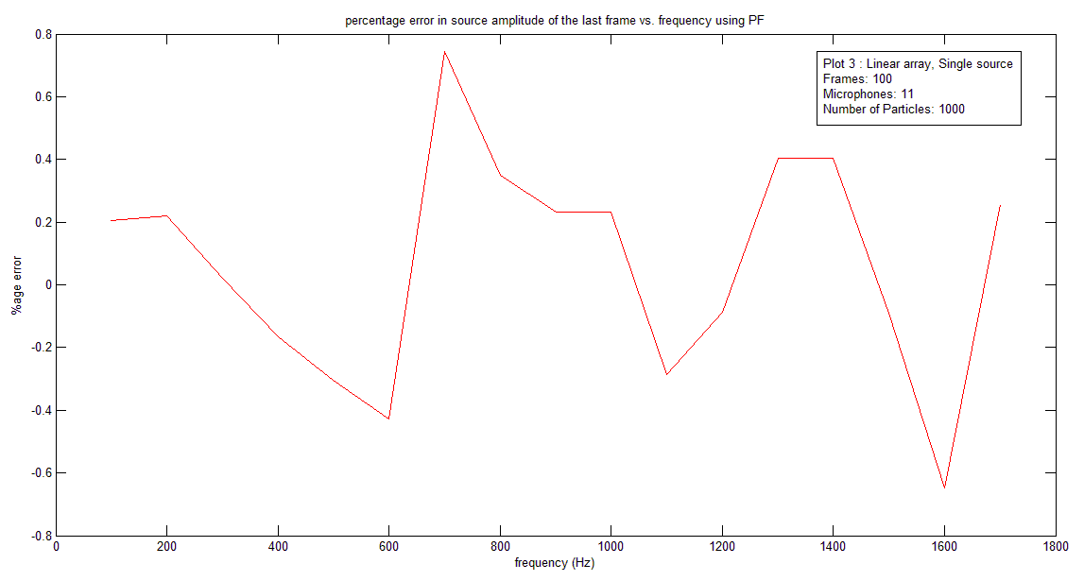

Slide 26
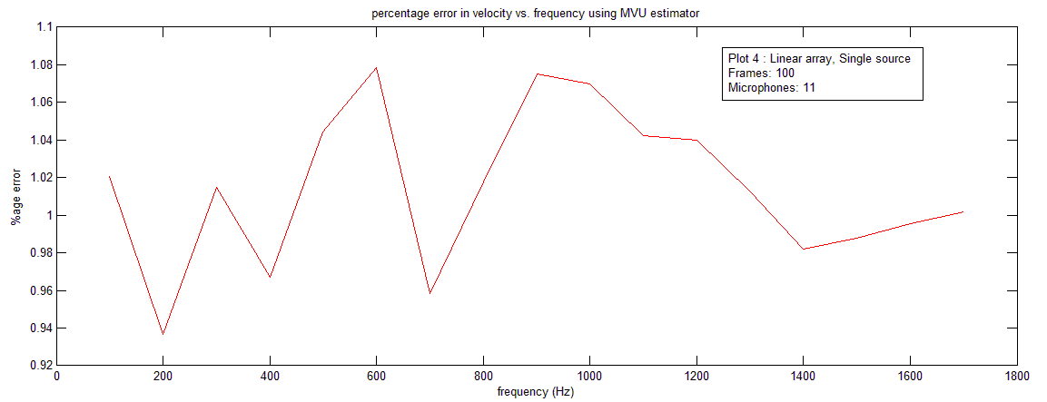

Slide 27
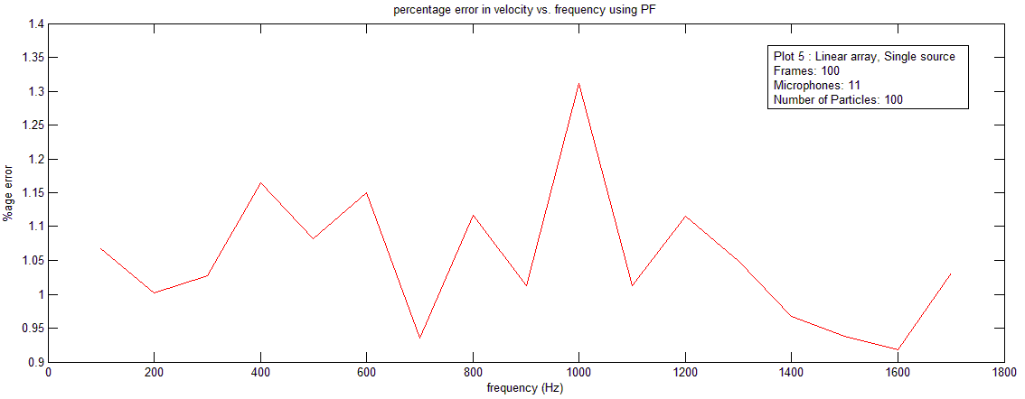

Slide 28
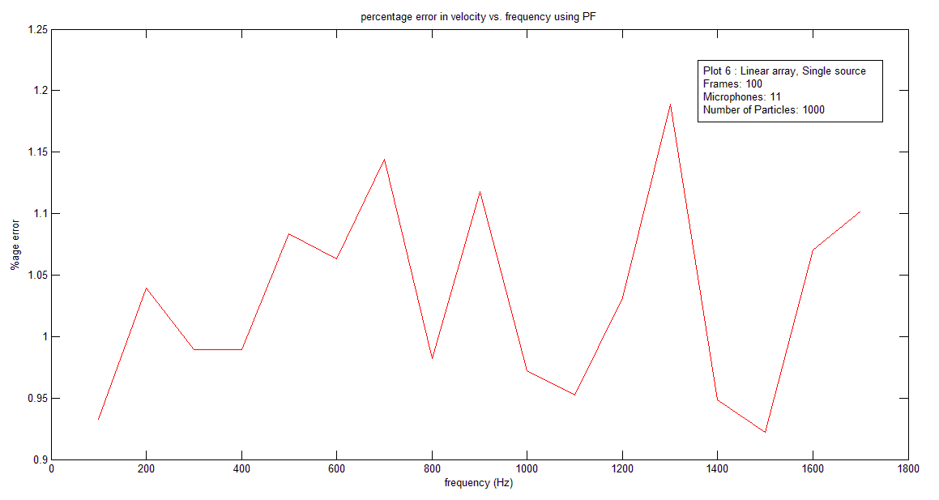

Slide 29
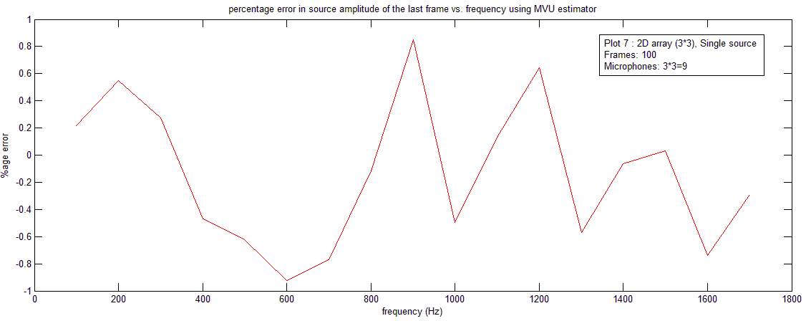
2-Dimensional array (3*3), Single Source

Slide 30
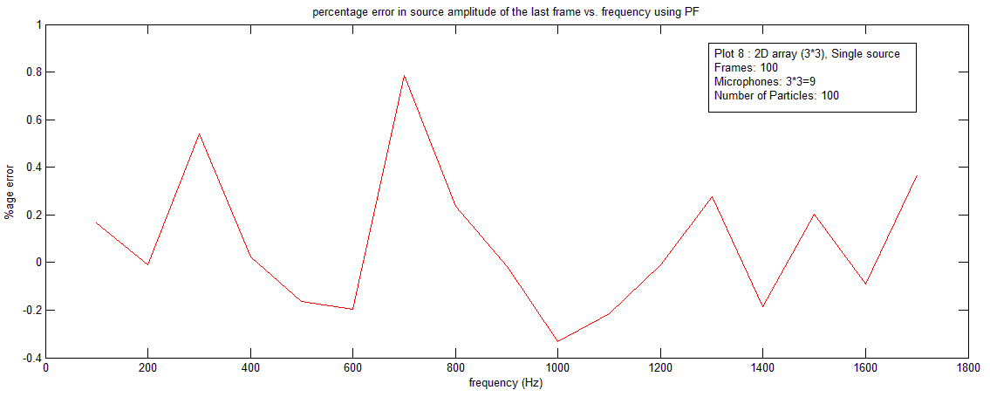

Slide 31
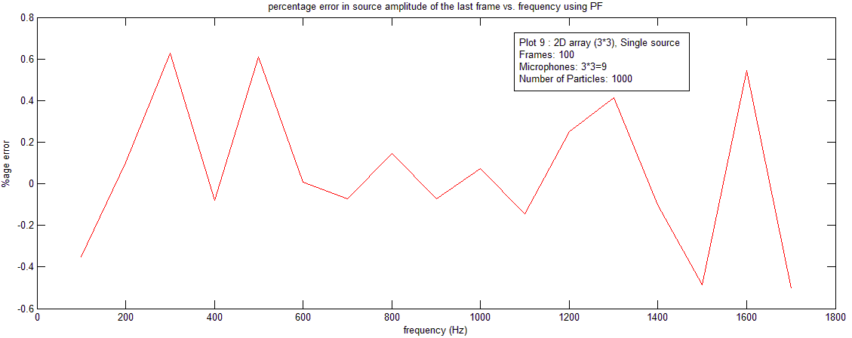

Slide 32
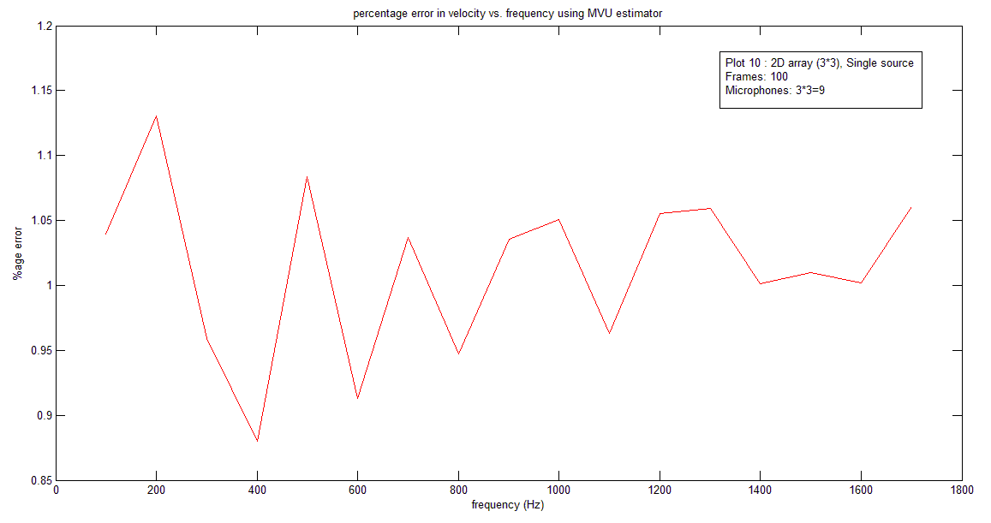

Slide 33
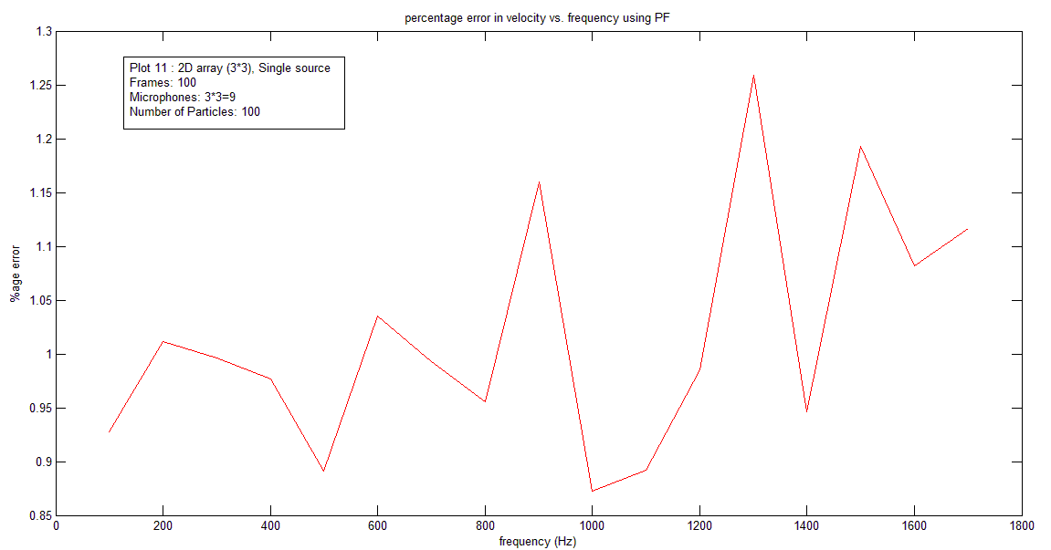

Slide 34
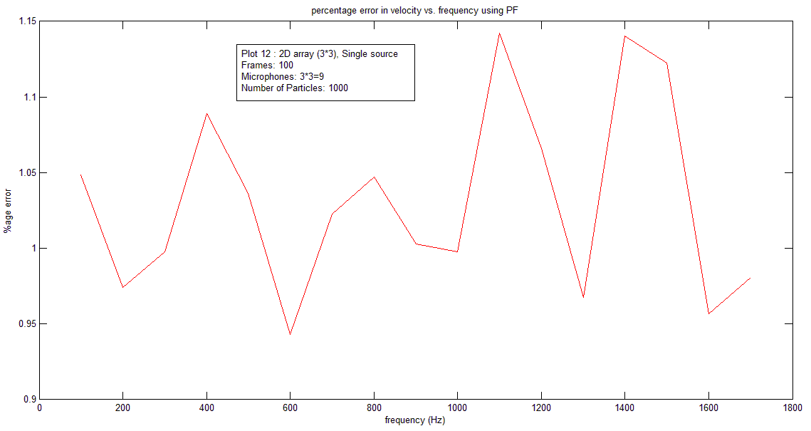

Slide 35
Things to do next…
Add suitable prior and evidence functions in the weight update equation according to the Antoni’s paper.
Make JASA paper outline under following section headings:
Introduction
Theoretical background
How this problem can be fitted into particle filter framework
Simulation and Results
Conclusions
Apply EM (Expectation maximization) algorithm to the same problem if time remains.

Slide 36
Thank you for listening

